Slide 1
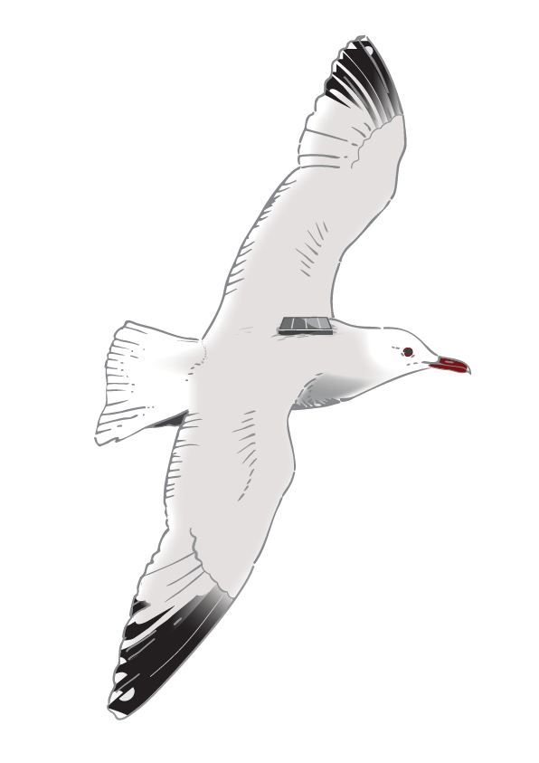



CHANGES IN FALL MIGRATION OF EUROPEAN HONEY BUZZARD (Pernis apivorus) IN VALLE STURA DI DEMONTE
Michela Fadda, Fabiano Sartirana, Elisa Avanzinelli, Luca Giraudo, Stefano Leonardi

Slide 2
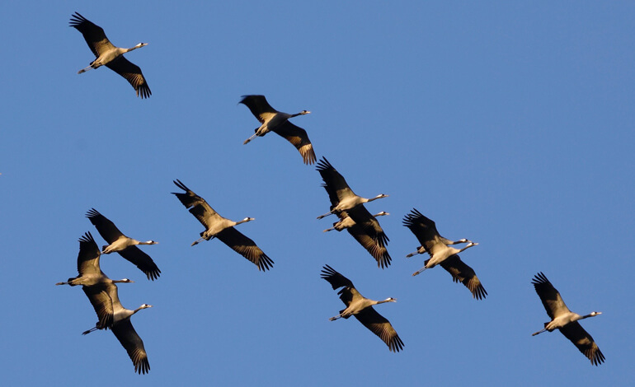
MIGRATION AND CLIMATIC CHANGES
MIGRATION
Increased migration speed
Environmental conditions not yet suitable for the reproduction and survival of species
Change in species phenology
Decrease in fitness
Change in the structure, health and functioning of ecosystems

Slide 3
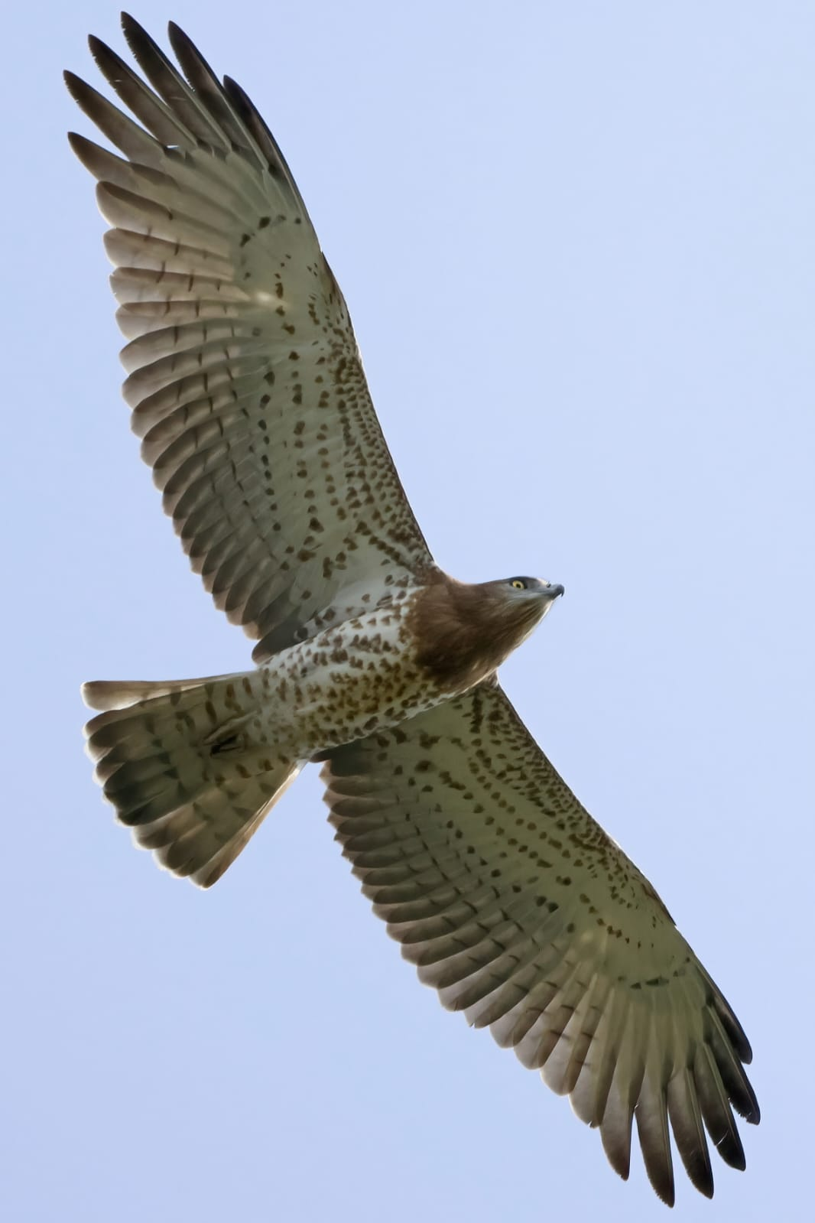
THE TIMING OF MIGRATION IN Pernis apivorus
The effects of climate change on the annual cycle of animals remains poorly studied and understood. Many studies focus on spring migration, but not post-nuptial migration
Filippi-Codaccioni, Ondine, et al. "Advanced departure dates in long-distance migratory raptors." Journal of Ornithology 151 (2010): 687-694.
Frei, Barbara, et al. "Community‐science reveals delayed fall migration of waterfowl and spatiotemporal effects of a changing climate." Journal of Animal Ecology 93.4 (2024)
Species-level bias: Most studies deal with passerines, but not birds of prey
  Filippi-Codaccioni, Ondine, et al. "Advanced departure dates in long-distance migratory raptors." Journal of Ornithology 151 (2010): 687-694.

Slide 4
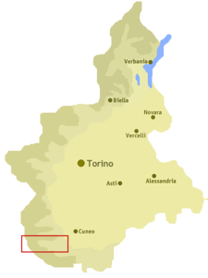
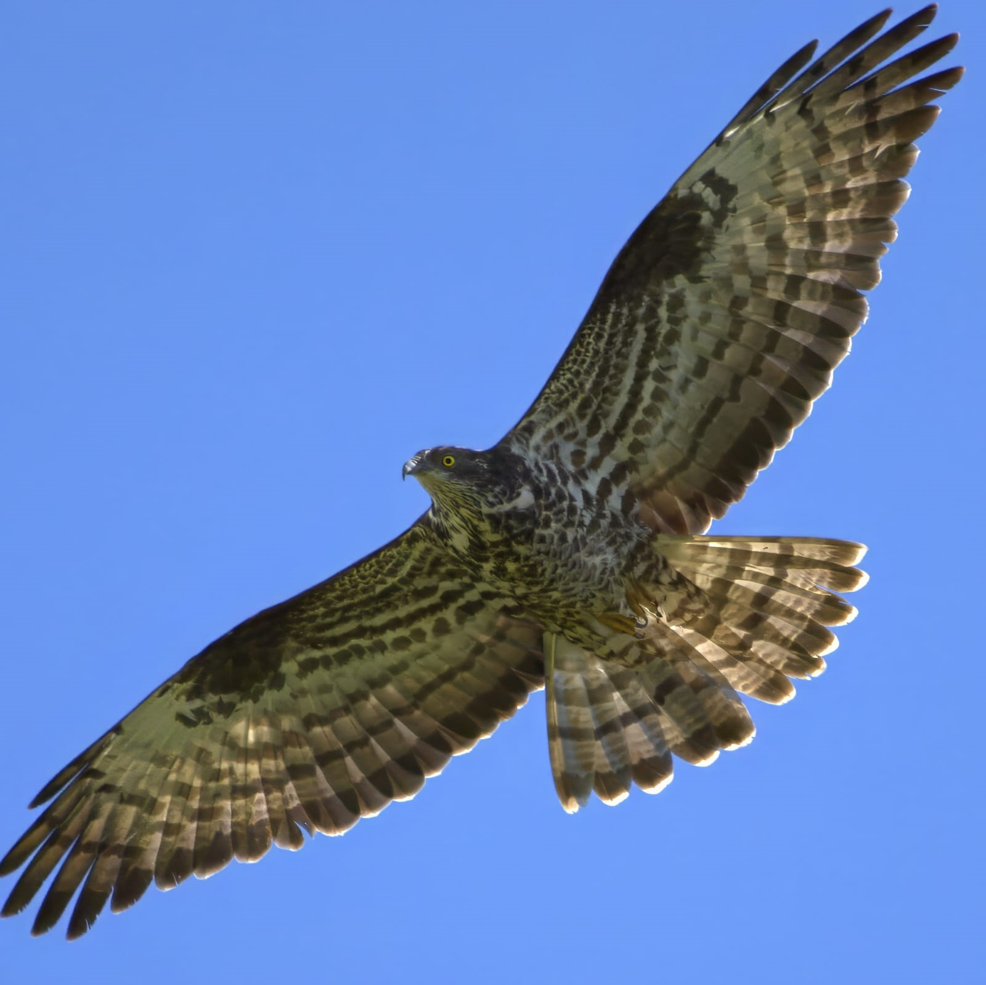
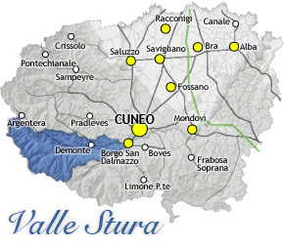

OBJECTIVE
Has the migration timing of the Honey Buzzard (Pernis apivorus) changed in Valle Stura di Demonte?
If so, has it changed due to climate change?

Slide 5
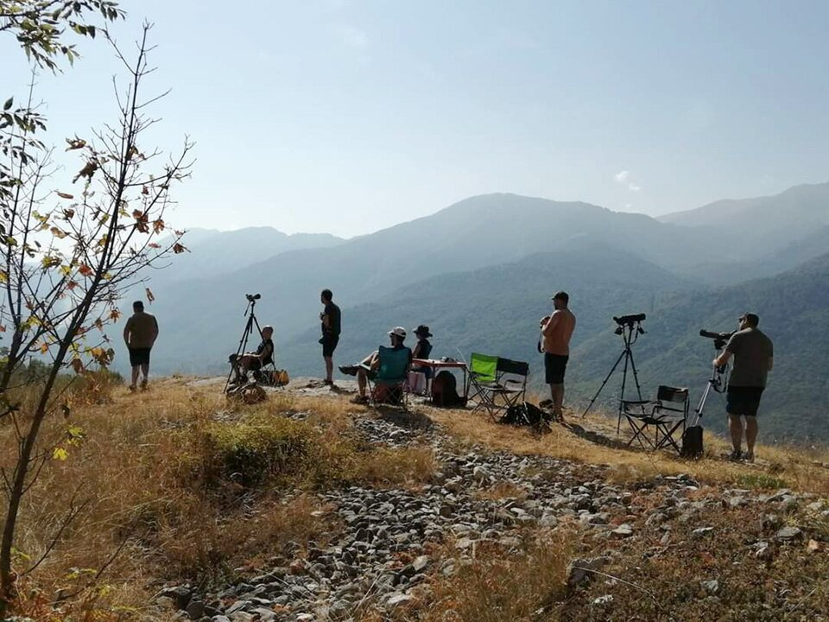
DATA
Monitoring data of honey buzzard passages collected during the XXXIV Migrans camp, held from 18th August to 30th September 2024
Historical data from the monitoring of the Migrans project, from 1991 to today
Meteorological data collected from weather stations in the vicinity of the observation field

Slide 6
MATERIALS AND METHODS
THE AREA OF STUDY
Link between plain and France (60 Km from Borgo San Dalmazzo to Colle della Maddalena)
Suitable for human and animal movements
Thanks to the geological conformation, there is a lot of flora and fauna richness
The migratory passage of diurnal birds of prey and storks is very important

Slide 7
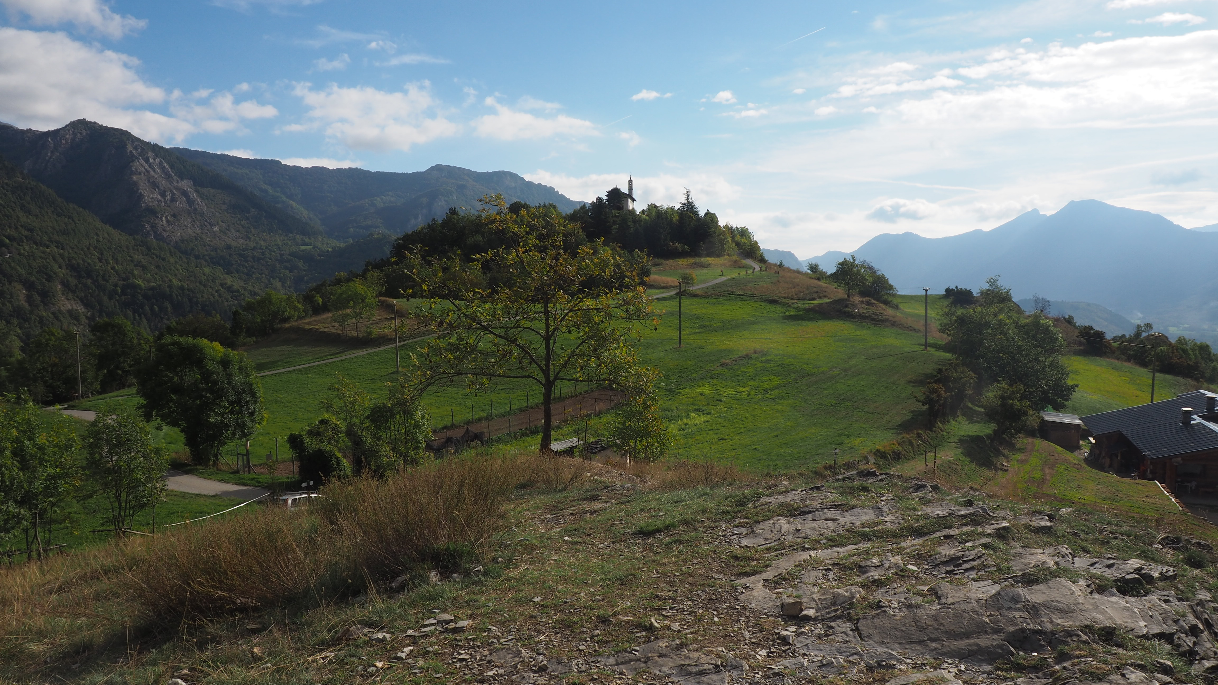
MATERIALS AND METHODS
THE WATCHSITES
Madonna del Pino
Between Valle Stura and Vallone dell’Arma, along one of the main migratory routes in Italy
No plants too tall near the watchsite
There is no disturbance
Optimal field of view

Slide 8
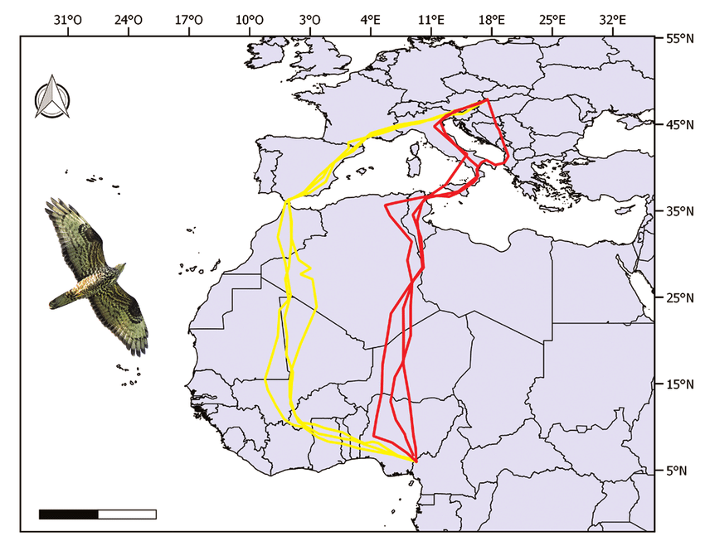
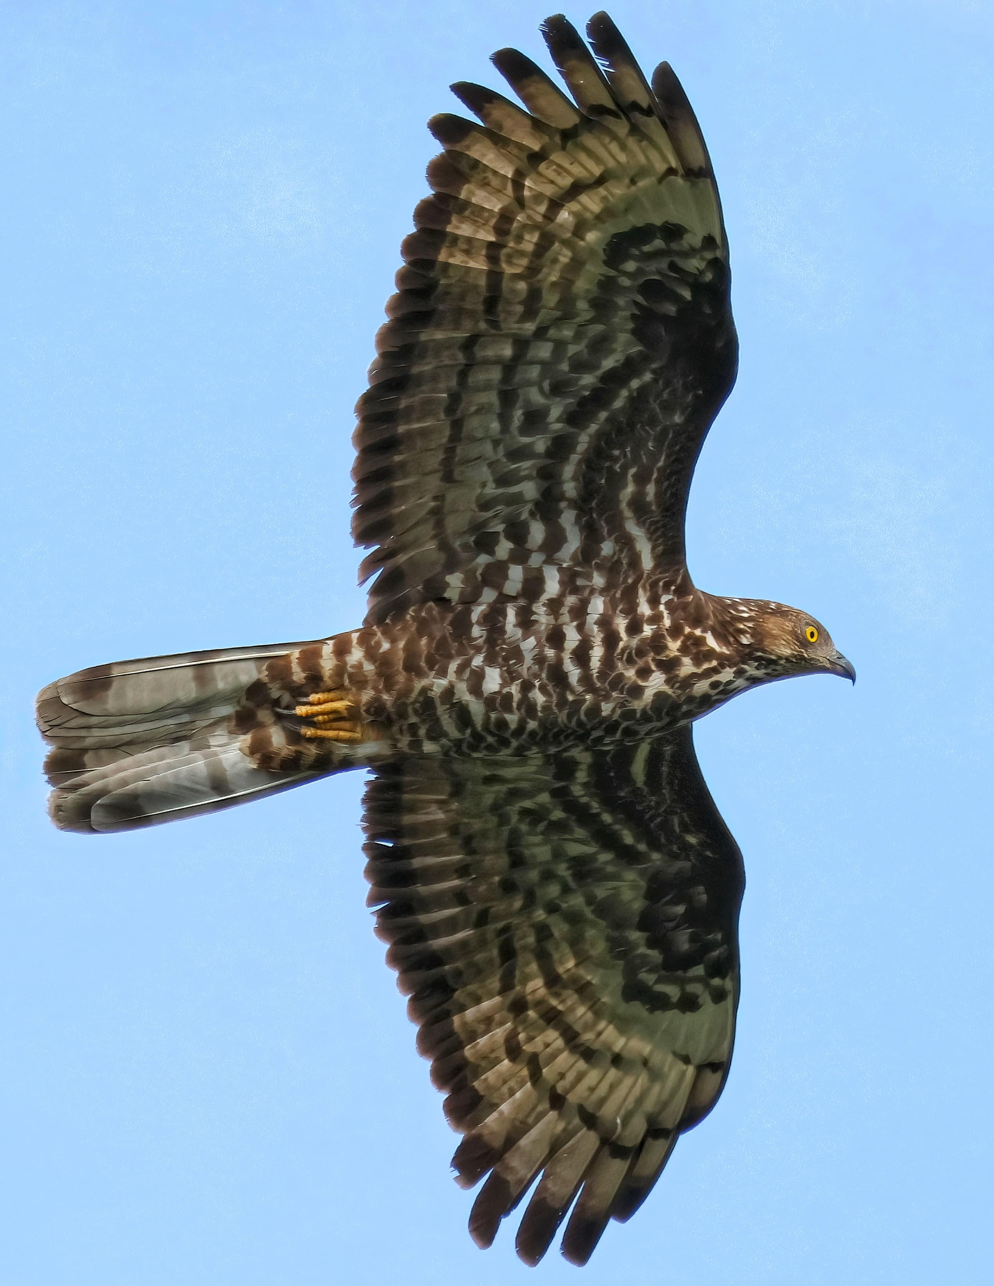
MATERIALS AND METHODS
The Honey Buzzard (Pernis apivorus)
THE SPECIE OF STUDY
Winter: Sub – Saharan Africa
Pre-nuptial migration: from early May
Breeding season: Europe and parts of Asia
Post-nuptial migration: from late August to mid September
Hymenoptera
Hornet (Vespa cabro)
DIET
Bumblebee Apinae
Common wasp (Vespula vulgaris)
Yellowjacket(Vespula germanica)
Rodents
Vole Arvicolinae

Slide 9
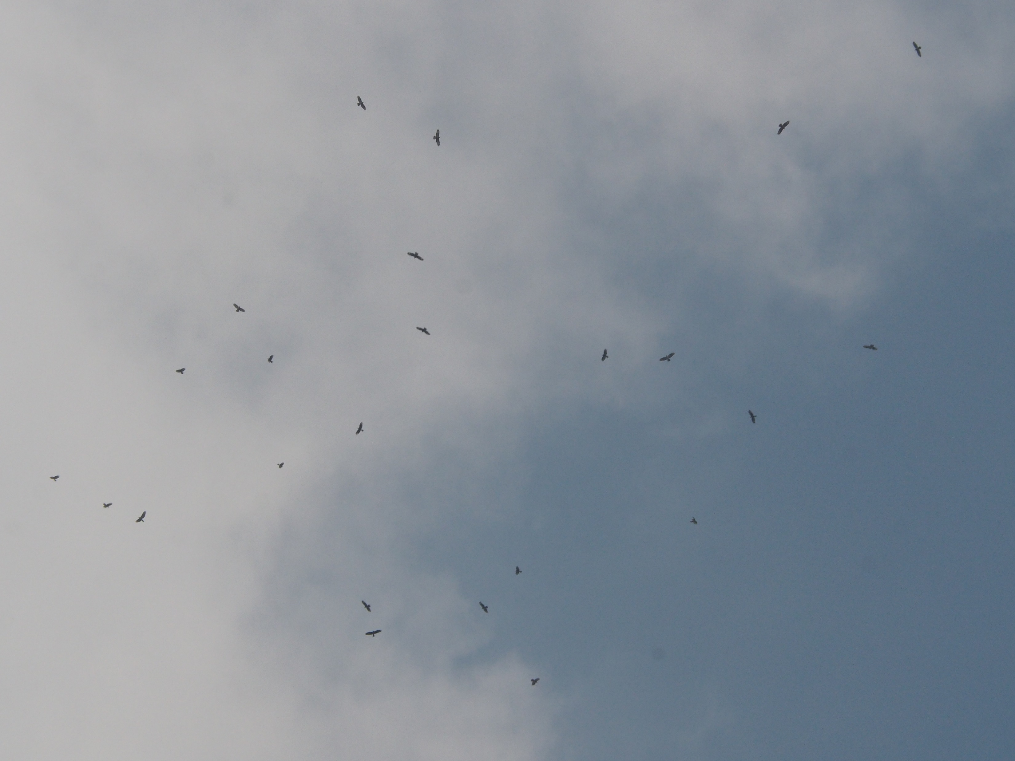
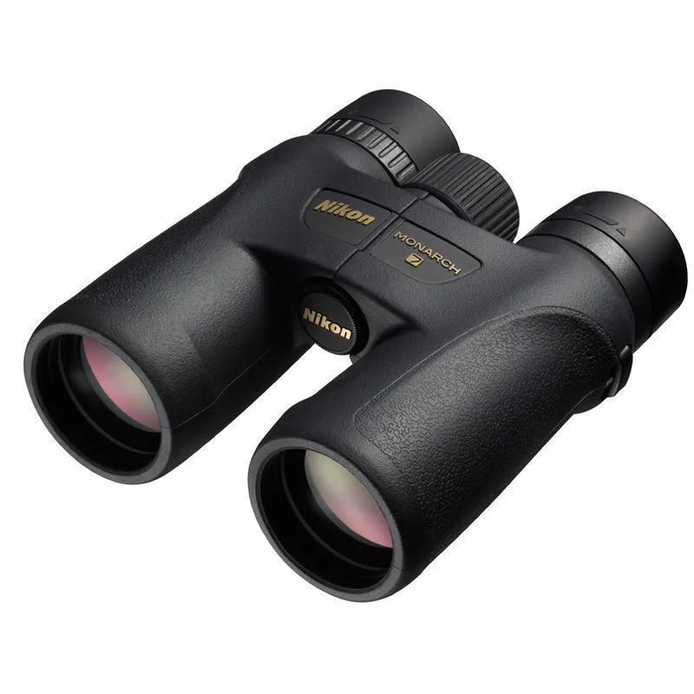
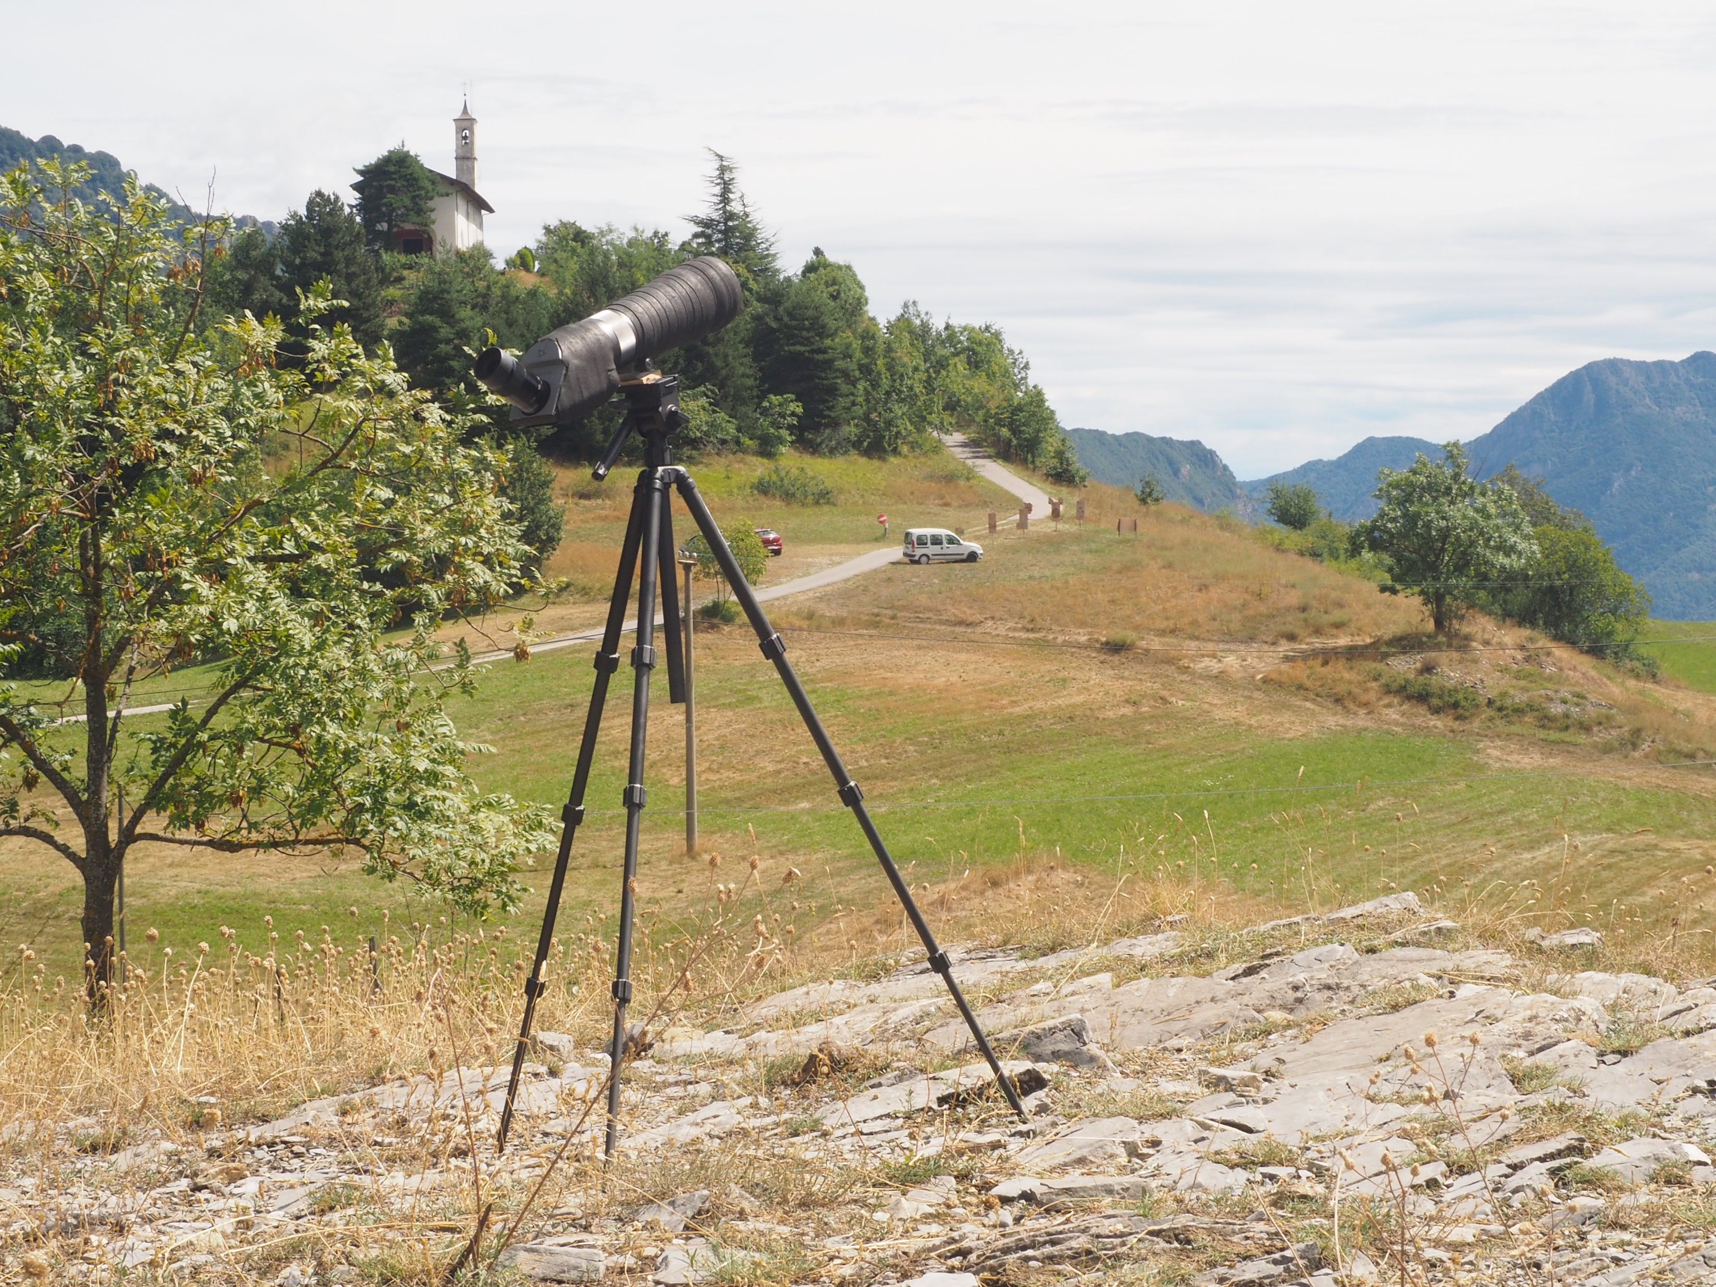
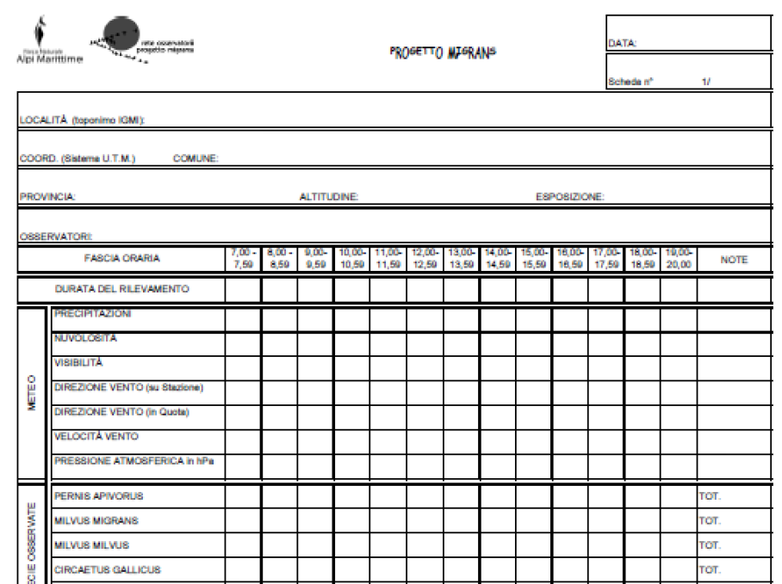
MATERIALS AND METHODS
MONITORING
DATA FROM 1991 TO 2024
Every day from 9 am to 5 pm
Visual count, in which every year volunteers, ranger park and Carabinieri help in monitoring

Slide 10
MATERIALS AND METHODS
DATA ANALYSIS
DATI ANNUALI DI PASSAGGIO
Culbertson, K.A., Garland, M.S., Walton, R.K., Zemaitis, L., Pocius, V.M., 2022. Long-term monitoring indicates shifting fall migration timing in monarch butterflies (Danaus plexippus). Global Change Biology 28, 727–738.
PEAK DAY
MIGRATION MIDPOINT: defined as the day by which half of the Honey Buzzard counted throughout the migration season have passed through Madonna del Pino
Days on which the relative abundance was greater than the annual average daily abundance plus the annual average standard deviation
AVERAGE PEAK DAY: defined as the average of ordinal dates of peak migration days for each season
FIRST PEAK DAY: first peak day during the migration
WEIGHTED AVERAGE PEAK DAY: individual-weighted average of peak ordinal days during the migration season

Slide 11
MATERIALS AND METHODS
DATA ANALYSIS
ANNUAL DATA OF PASSAGES
STANDARD DEVIATION
It provides information about the progress of individuals' passages over time
AVERAGE OF ORDINARY DAYS
Was there a concentration or dilution of migratory passages over time?
The average of ordinal days in which individuals migrate
LINEAR REGRESSION

Slide 12
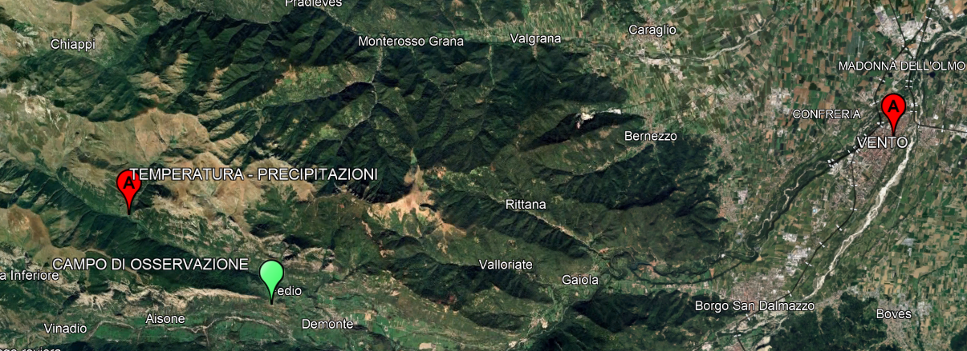

MATERIALS AND METHODS
CLIMATIC DATA
Honey Buzzard doesn’t spend a lot of energy during its migration
Updrafts that are formed by the wind
They exploit many ways
Thermal currents that are formed by the temperature
They don’t move in the rain

Slide 13

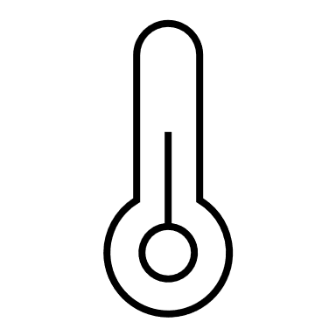

MATERIALS AND METHODS
DATA ANALYSIS
WIND
TEMPERATURE
PRECIPITATION
Direction
Speed
Max. T
Min. T
Average
Max. rain
Min. rain
Average

Slide 14
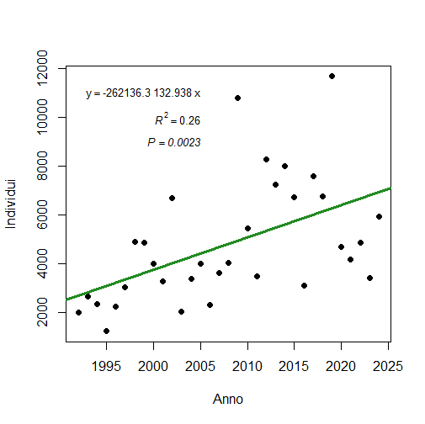
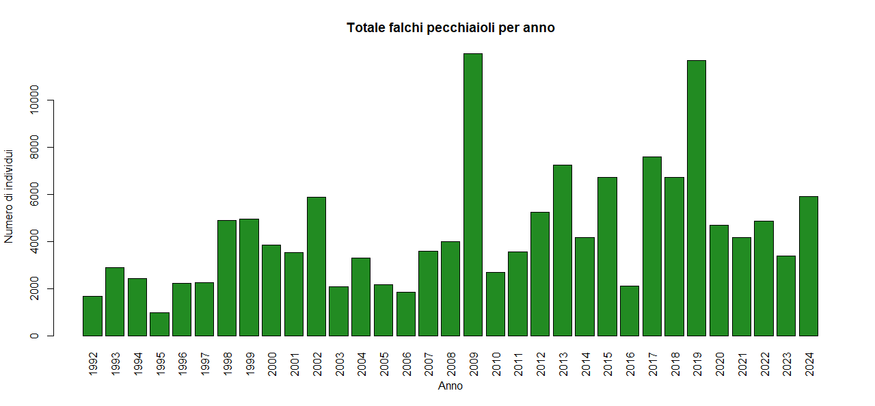
+
DATA
Individuals
Total of honey buzzard for year
Annual average: 4694 individuals
Years
Individuals
Years

Slide 15
ADVANCE
EXPECTED RESULTS
Peak days
POSTPONE
Peak days
Years
COSTANCE
Peak days
Years
Years

Slide 16
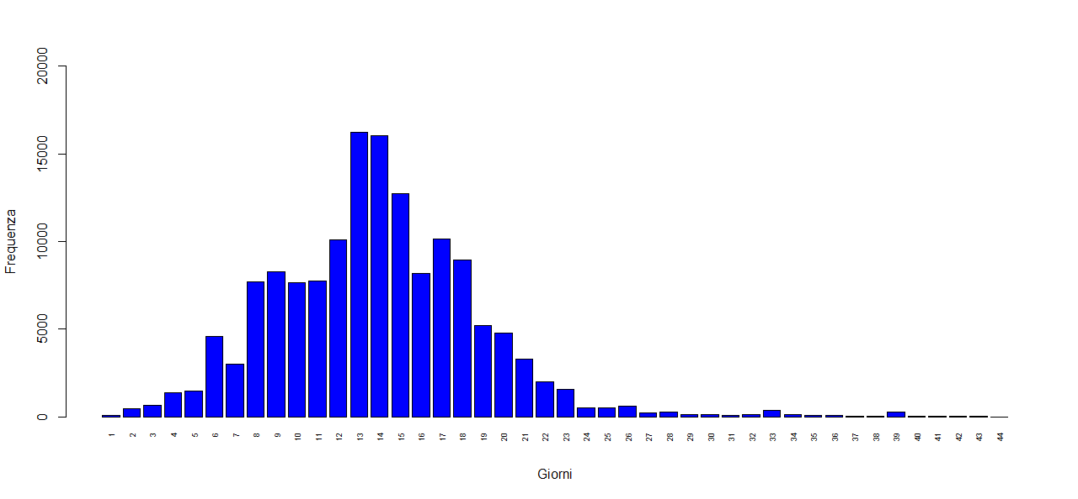
RESULTS
Frequency of passages on monitoring days from 1992 to 2024
Period from 17th August (day 1) al 30th September (day 45)
Consistent and consistent steps from the 8th day up to the 20th day
Frequency
Major passages recorded between the 13th and 15th day, therefore between August 29th and August 31st
Days

Slide 17
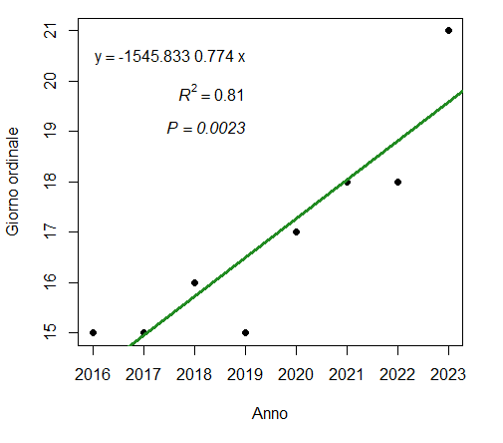
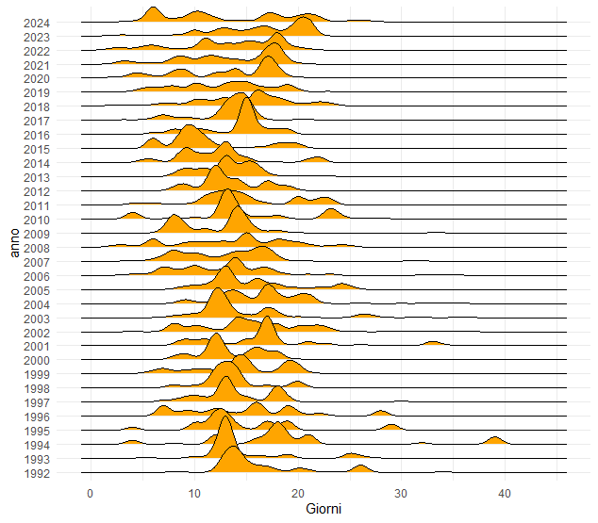

RESULTS
+
Individuals passed through each year on individual days
Ordinal day
There is great variability from one year to the next and therefore there does not appear to be a constant migration trend
Years
Years
Trend shifted to the right especially in the last years of monitoring (2016 – 2023)
Days

Slide 18
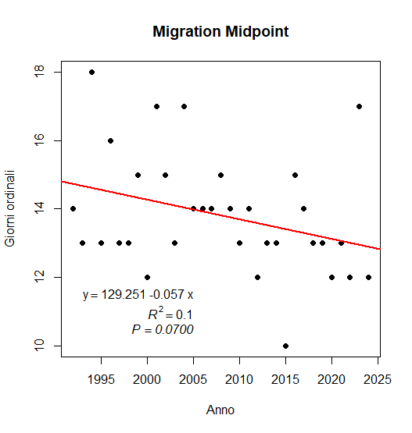
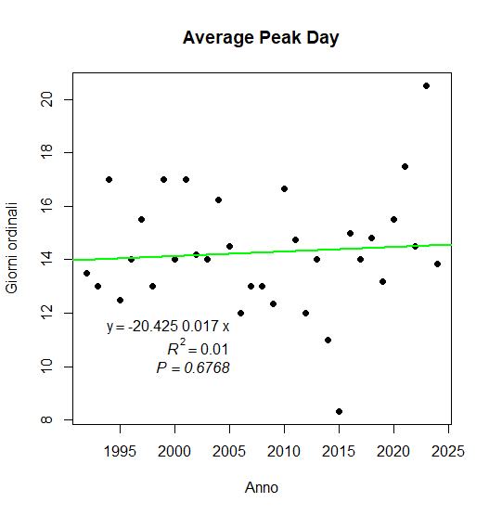
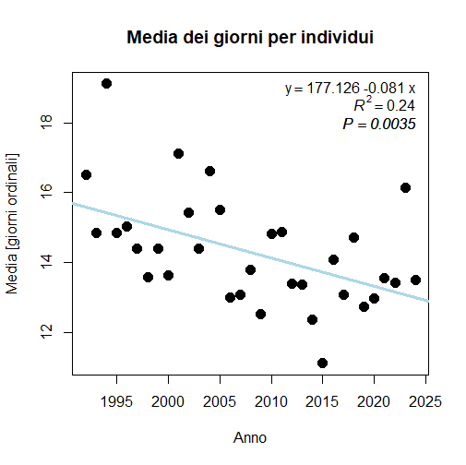
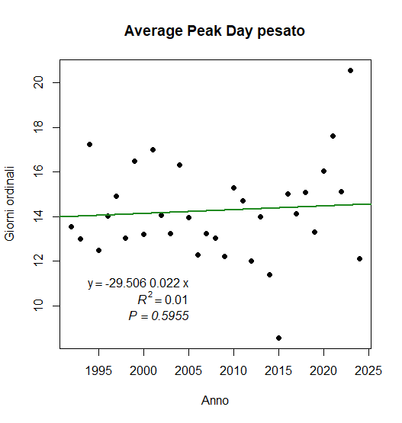
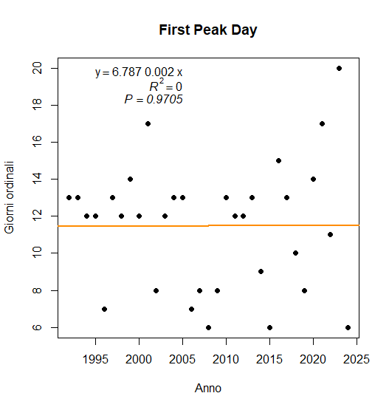
RESULTS
Average of ordinal days
Ordinal day
Ordinal day
Year
Year
]
Average [ordinal day]
Ordinal day
Ordinal day
Year
Year
ANTICIPO medio di 2,6 gg
dal 1992 al 2024
Year

Slide 19
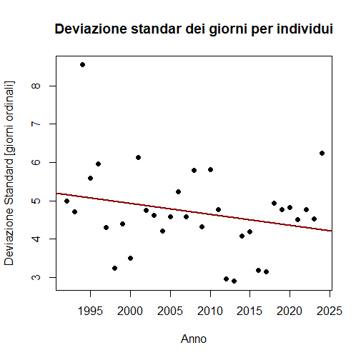

RESULTS
Standard deviation
There is no evident concentration or dilution over time of the passage of individuals
Deviation standard [ordinal day]
Year

Slide 20
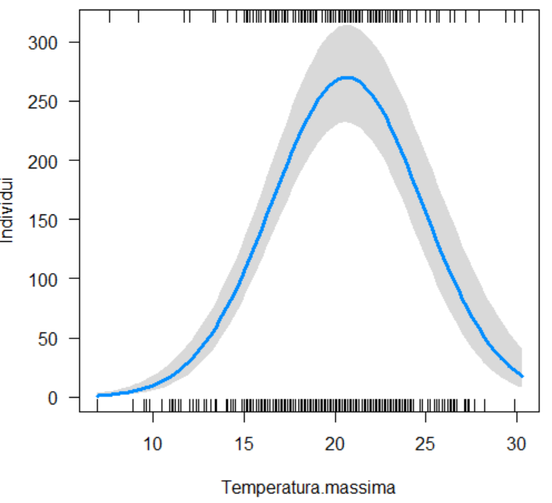
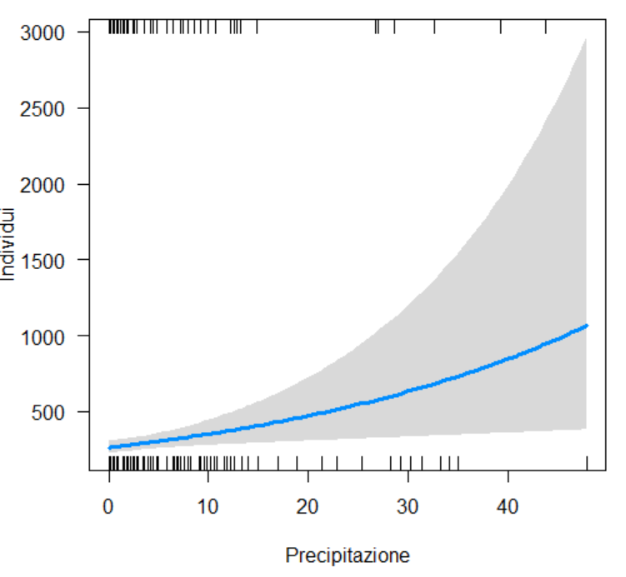
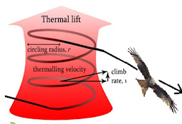
RESULTS
DAILY CLIMATIC DATA
Individuals
Individuals
Maximum temperature [°C]
Precipitation [mm]
Individuals increase until they reach a peak T and then begin to decrease
Individuals increase as rainfall increases

Slide 21
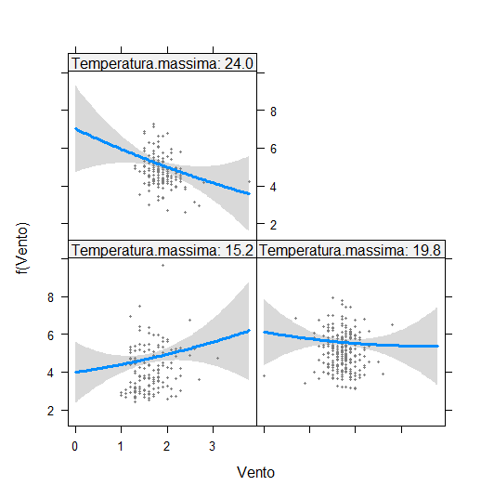
RESULTS
DAILY CLIMATIC DATA
Maximum temp: 24°C
INTERACTION BETWEEN WIND AND MAXIMUM TEMPERATURE
Low T = 15,2°C
Average T = 19,8°C
High T = 24,0°C
f (Wind)
Maximum temp: 15.2°C
Maximum temp: 19.8°C
As the wind speed increases, the number of individuals passing by decreases.
Wind

Slide 22
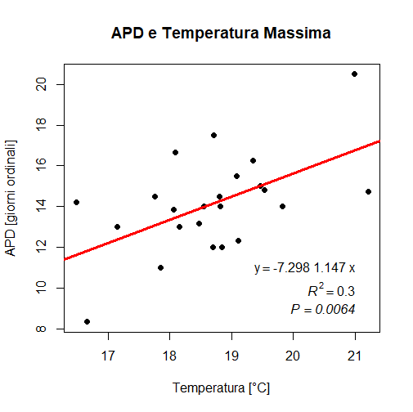
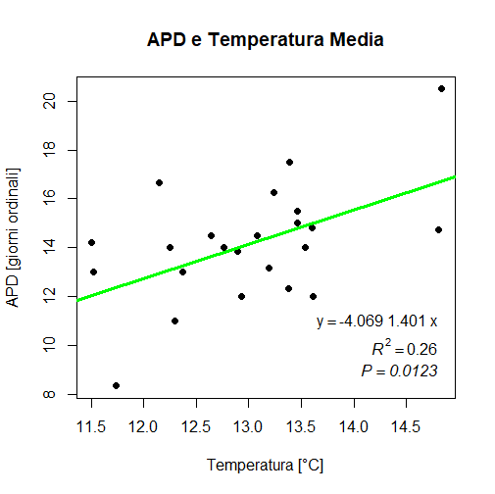
RESULTS
ANNUAL CLIMATIC DATA
APD and maximum temperature
APD and average temperature
APD [ordinal day]
APD [ordinal day]
+
+
Temperature [°C]
Temperature [°C]
Average Peak Day depends on the maximum temperature and the average temperature

Slide 23
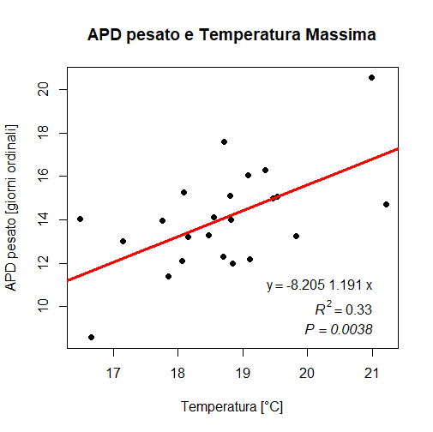
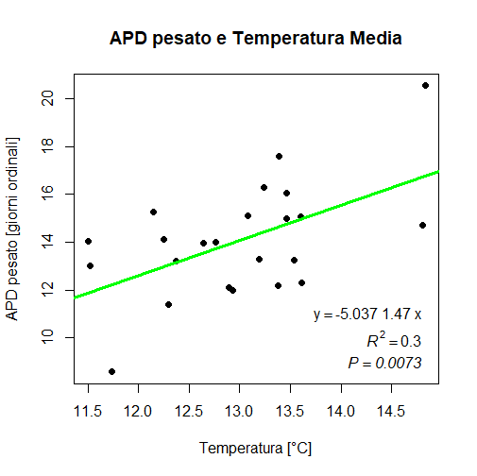
RESULTS
ANNUAL CLIMATIC DATA
Weighted APD and maximum temperature
Weighted APD and maximum temperature
Weighted APD [ordinal day]
Weighted APD [ordinal day]
+
+
Temperature [°C]
Temperature [°C]
Weighted Average Peak Day depends on maximum temperature and on average temperature

Slide 24
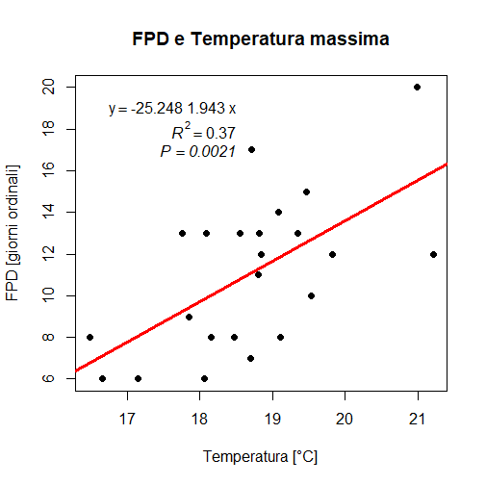
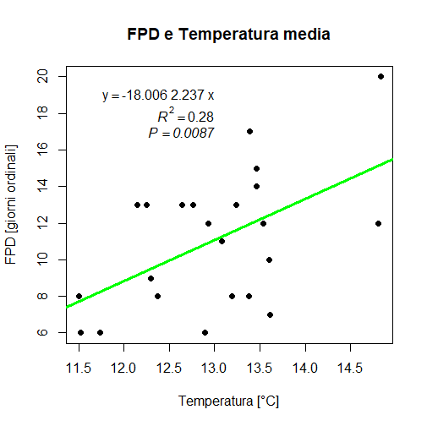
RESULTS
ANNUAL CLIMATIC DATA
FPD and maximum temperature
FPD and average temperature
+
+
APD [ordinal day]
APD [ordinal day]
Temperature [°C]
Temperature [°C]
First Peak Day depends on maximum temperature and on average temperature

Slide 25
RESULTS
DAILY CLIMATIC DATA
Temperatura Massima
Precipitazioni
ANNUAL CLIMATIC DATA

Slide 26
CONCLUSIONS
Has the honey buzzard (Pernis apivorus) changed its migration timing in the Stura di Demonte Valley?
    Over the years of monitoring from 1992 to 2024, the migration of the Honey Buzzard, at this specific crossing point, has not changed much.
    Large variability of data from one year to the next.
    The average number of passage days for individuals has been brought forward over the years by 2.6 days.
RESULTS OPPOSITE TO EXPECTED

Slide 27
CONCLUSIONS
POSTPONE
Frei, B., Cox, A.R., Morales, A.C., Roy, C., 2024. Community-science reveals delayed fall migration of waterfowl and spatiotemporal effects of a changing climate. Journal of Animal Ecology 93, 377–392.
Culbertson, Katherine A., et al. Long‐term monitoring indicates shifting fall migration timing in monarch butterflies (Danaus plexippus). Global Change Biology 28.3: 727-738 (2022).
Le Corre, Mael, Christian Dussault, and Steeve D. Côté. Weather conditions and variation in timing of spring and fall migrations of migratory caribou. Journal of Mammalogy 98.1 (2017).
Filippi-Codaccioni, O., Moussus, J.-P., Urcun, J.-P., Jiguet, F., 2010. Advanced departure dates in long-distance migratory raptors. Journal of Ornithology 151, 687–694.
ADVANCE
Filippi-Codaccioni, O., Moussus, J.-P., Urcun, J.-P., Jiguet, F., 2010. Advanced departure dates in long-distance migratory raptors. Journal of Ornithology 151, 687–694.
ANTICIPO
Filippi-Codaccioni, O., Moussus, J.-P., Urcun, J.-P., Jiguet, F., 2010. Advanced departure dates in long-distance migratory raptors. Journal of Ornithology 151, 687–694.
COSTANCE
Haest, Birgen, et al. Climatic drivers of (changes in) bat migration phenology at Bracken Cave (USA). Global Change Biology 27.4 (2021)
Ethier, Danielle M., and Greg W. Mitchell. Effects of climate on fall migration phenology of monarch butterflies departing the northeastern breeding grounds in Canada. Global Change Biology 29.8: 2122-2131 (2023).

Slide 28
CONCLUSIONS
Is there a relationship between the passage of individuals and meteorological variables?
    On a daily basis, temperature and precipitation positively influence the passage of honey buzzards. However, when temperatures are too high, passages tend to decrease.
    As precipitation increases, the passages increase.
    Raptors slow down their migration when the wind is strong and temperatures are high.
    Annually, in warmer years, the average peak day, the weighted average peak day, and the first peak day are later than in colder years. Therefore, honey buzzards tend to slow down their migration when it's warmer.
    To gain a more complete understanding of the relationship between weather conditions and migration, data from Central Europe should also be considered.

Slide 29
BIBLIOGRAPHY
Filippi-Codaccioni, Ondine, Jean-Pierre Moussus, Jean-Paul Urcun, e Frédéric Jiguet. «Advanced departure dates in long-distance migratory raptors». Journal of Ornithology 151 (2010): 687–94.
Kunz, Thomas H, Sidney A Gauthreaux Jr, Nickolay I Hristov, Jason W Horn, Gareth Jones, Elisabeth KV Kalko, Ronald P Larkin, et al. «Aeroecology: probing and modeling the aerosphere». Integrative and comparative biology 48, fasc. 1 (2008): 1–11.
Both, Christiaan, e Luc te Marvelde. «Climate change and timing of avian breeding and migration throughout Europe». Climate Research 35, fasc. 1–2 (2007): 93–105.
Haest, Birgen, Phillip M Stepanian, Charlotte E Wainwright, Felix Liechti, e Silke Bauer. «Climatic drivers of (changes in) bat migration phenology at Bracken Cave (USA)». Global Change Biology 27, fasc. 4 (2021): 768–80.
Baccetti N., Fracasso G. & Commissione Ornitologica Italiana. – «Lista CISO-COI 2020 degli uccelli italiani». Avocetta, 2021.
Bergen, Valentijn S van. «The honey-buzzards of the Sensebezirk: first findings on density, diet, reproduction and food competition in a Swiss population of honey-buzzard Pernis apivorus». Diet, Reproduction and Food Competition in a Swiss Population of Honey-Buzzard Pernis Apivorus (December 12, 2019), 2019.
Bildstein, KEITH L, JEFF P Smith, e REUVEN Yosef. «Migration counts and monitoring». Raptor Re search and Management Techniques. Edited by DM Bird and KL Bildstein. Hancock House Publishers, Washington, DC, USA, 2007, 101–15.
Bowlin, Melissa S, e Martin Wikelski. «Pointed wings, low wingloading and calm air reduce migratory flight costs in songbirds». PloS one 3, fasc. 5 (2008): e2154.
Brichetti P. & Fracasso G. – «Ornitologia Italiana. Vol. 1. Gaviidae-Falconidae». Alberto Perdisa Editore, Bologna. Pp:463., 2023
Caula, Bruno, Pier Luigi Beraudo, e Massimo Pettavino. Gli uccelli delle Alpi. Il Castello, 2022.

Slide 30
BIBLIOGRAPHY
Clark, WS. «Techniques and methodology used to study raptor migration». ICBP Technical Publication 5 (1985): 229–36.
Culbertson, Katherine A, Mark S Garland, Richard K Walton, Louise Zemaitis, e Victoria M Pocius. «Long-term monitoring indicates shifting fall migration timing in monarch butterflies (Danaus plexippus)». Global Change Biology 28, fasc. 3 (2022): 727–38.
Dunn, Erica H, David JT Hussell, e E Ruelas Inzunza. «Recommended methods for population monitoring at raptor-migration watchsites». State of North America’s Birds of Prey, Series in Ornithology, fasc. 3 (2008): 447–60.
Ethier, Danielle M, e Greg W Mitchell. «Effects of climate on fall migration phenology of monarch butterflies departing the northeastern breeding grounds in Canada». Global Change Biology 29, fasc. 8 (2023): 2122–31.
Fleming, Theodore H, Peggy Eby, TH Kunz, e MB Fenton. «Ecology of bat migration». Bat ecology 156 (2003): 164–65.
Forsman, Dick. «Identificare i rapaci in volo. Europa, Nord Africa e Medio Oriente». Ricca Editore, 2020.
Frei, Barbara, Amelia R Cox, Ana C Morales, e Christian Roy. «Community-science reveals delayed fall migration of waterfowl and spatiotemporal effects of a changing climate». Journal of Animal Ecology 93, fasc. 4 (2024): 377–92.
Gamauf, A, e E Haring. «Molecular phylogeny and biogeography of honey-buzzards (genera Pernis and Henicopernis)». Journal of Zoological Systematics and Evolutionary Research 42, fasc. 2 (2004): 145–53.
Gustin M., Brambilla M. & Celada C., «Conoscerli, proteggerli. Guida allo stato di conservazione degli uccelli in Italia«. LIPU, Pp:448, 2019.
Itämies, JUHANI, e H Mikkola. «The diet of honey buzzards Pernis apivorus in Finland». Ornis Fennica 49, fasc. 1 (1972): 7–10.
La Sorte, Frank A, Wesley M Hochachka, Andrew Farnsworth, Daniel Sheldon, Daniel Fink, Jeffrey Geevarghese, Kevin Winner, Benjamin M Van Doren, e Steve Kelling. «Migration timing and its determinants for nocturnal migratory birds during autumn migration». Journal of Animal Ecology 84, fasc. 5 (2015): 1202–12.

Slide 31
BIBLIOGRAPHY
Lack, David. «The natural regulation of animal numbers.», 1954.
Le Corre, Mael, Christian Dussault, e Steeve D Côté. «Weather conditions and variation in timing of spring and fall migrations of migratory caribou». Journal of Mammalogy 98, fasc. 1 (2017): 260–71.
Martín-Ávila, Jorge A, Salvador Rebollo, José M Fernández-Pereira, e Luisa M Díaz-Aranda. «The trophic strategy of the European honey-buzzard Pernis apivorus during breeding: extravagant specialization or ingenious solution?» Journal of Avian Biology, 2024, e03221.
Newton, Ian. «The migration ecology of birds». Elsevier, 2023.
Perdisa Editore, Bologna. Pp:463.
Pavia M. & Boano G., «Check-list degli uccelli del Piemonte e della Valle d’Aosta aggiornata al dicembre 2008». Rivista Italiana di Ornitologia, 79 (1): 23-47, 2009.
Sartirana, Fabiano. «Relazione progetto Migrans 2024», ottobre 2024.
Shaw, Allison K. «Drivers of animal migration and implications in changing environments». Evolutionary Ecology 30 (2016): 991–1007.
Toffou Roberto e Cesare Bellone. «Osservazioni sulla migrazione autunnale dei rapaci diurni sulle Alpi Marittime», 1996.
Valle Stura, guida a una valle di confine: un affascinante mondo tra due mondi. + eventi, s.d.
Vegvari, Zsolt, Veronika Bokony, Zoltan Barta, e Gabor Kovacs. «Life history predicts advancement of avian spring migration in response to climate change». Global Change Biology 16, fasc. 1 (2010): 1–11.
Wilcove, David S. «No way home: the decline of the world’s great animal migrations». Island Press, 2010.

Slide 32
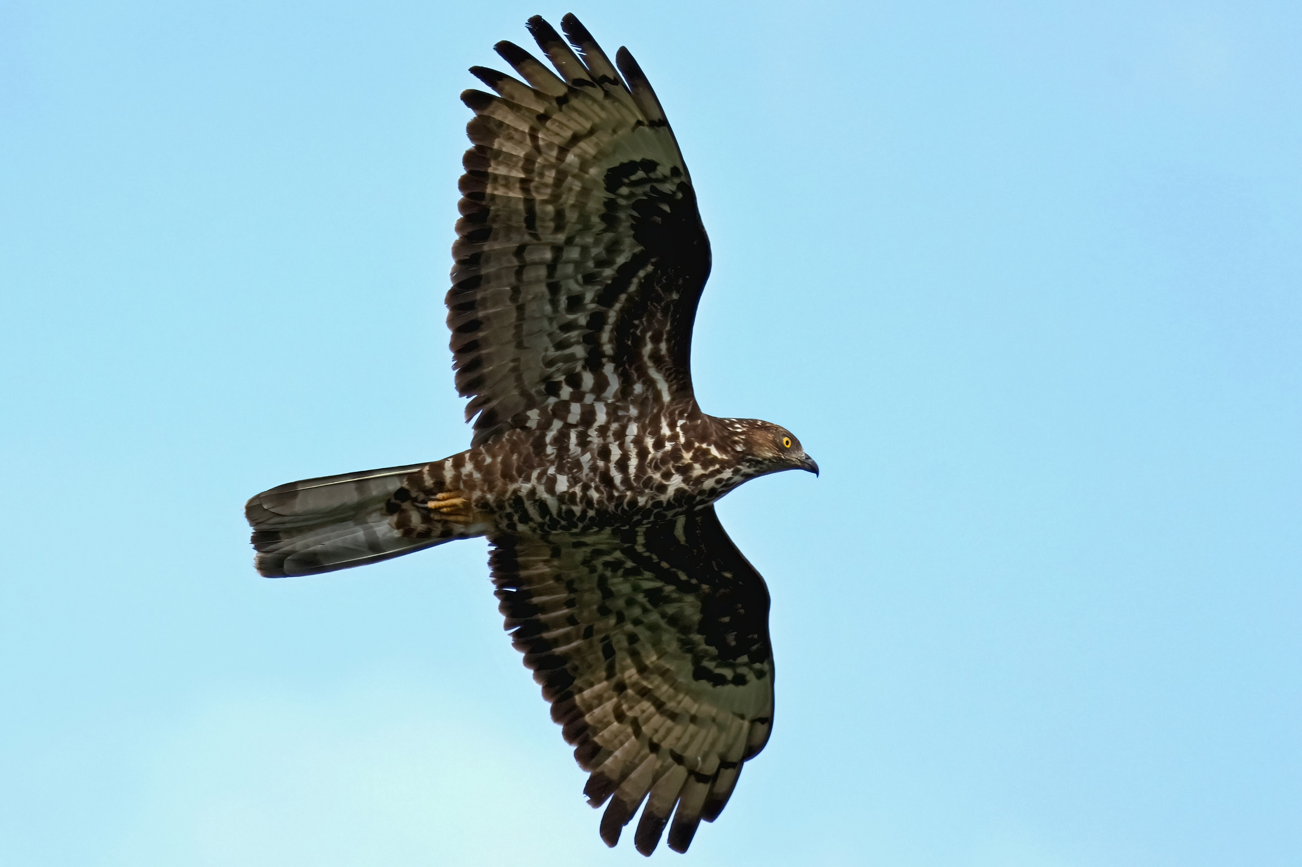
THAKS FOR YOUR ATTENTION

